Slide 1

DOMAIN NAME :DEEP LEARNING
TITLE: DRIVER DROWSINESS DETECTION
SYSTEM
TEAM MEMBERS:
1.Divya C - 811721243015
2.Mirdula S - 811721243028
3.Swetha S - 811721243056
4.SriAshika M- 811721243304
GUIDE NAME
Mr. Joshua Isaac Assistant Professor (AI)

Slide 2
OBJECTIVE
Ensure driver’s safety
Prevents accidents due to drowsiness
Efficient prototype

Slide 3
PROBLEM DEFINITION
EXISTING SYSTEM:
Detects drowsiness but doesn’t alert others
PROPOSED SYSTEM:
Real time drowsiness of driver’s causing accidents and deaths
Especially in distance travelling
Detects heart attacks

Slide 4
LITERATURE SURVEY
S.NO | Title | Author & Year | Technique used | Demerits
1. | Privacy Preserving Federated Transfer Learning for Driver Drowsiness Detection | Linlin Zhang, (20 July 2022) | Transfer learning, federated learning | Communication Overhead , Security Concerns, Heterogeneous Data
2. | Driver Drowsiness Detection Using Multi-Channel Second Order Blind Identifications | Chao Zhang, January 10, 2019 | Blood volume pulse (BVP), Drowsiness detection, Second-order Blind identification (SOBI). | Data Collection Challenges, Generalization, Ethical Considerations

Slide 5
S.NO | Title | Author & Year | Technique used | Demerits
3. | Early Identification and Detection of Driver Drowsiness by Hybrid Machine Learning | Ayman Altameem , November 30,2021 | Pre processing and Feature extraction, machine learning, facial recognition | Implementation Complexity, False positives/ negatives ,Resource Intensive
4. | Real-Time Driver-Drowsiness Detection System Using Facial Features | Wanghua Deng and Rouxue wu August 21, 2019 | Convolutional neural network, fatigue detection, feature location, face tracking. | Environmental Factors, Hardware Requirements

Slide 6
S.NO | Title | Author & Year | Technique used | Demerits
5. | Detecting Human Driver Inattentive and Aggressive Driving Behavior Using Deep Learning: Recent Advances, Requirements and Open Challenges | Monagi H . Alkinani and Wazir Zada Khan | Deep learning, human inattentive driving behavior, abnormal behavior detection, | Resource Intensive, Generalization to Unseen Scenarios

Slide 7
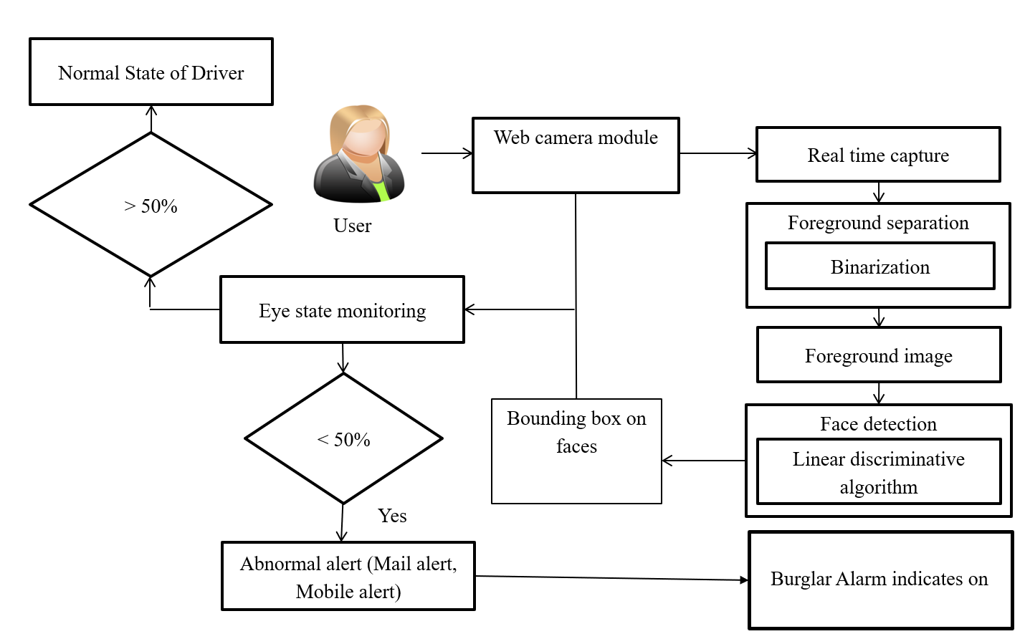
ARCHITECTURE DIAGRAM

Slide 8
SYSTEM SPECIFICATIONS
HARDWARE SYSTEM CONFIGURATION:
Computer - minimum of 4GB RAM & dual-core processor.
Webcam - at least 720p & high frame rate of at least 30fps.
Stable internet connection.
Storage
SOFTWARE SYSTEM CONFIGURATION:
Python programming language - Python serves as the primary programming language
Operating system - Windows, macOS, Linux distributions
Python libraries - OpenCV, D lib, TensorFlow
HTML/CSS or JavaScript - for UI design.

Slide 9
MODULES
Image Processing Module
Drowsiness Detection Module
Alerting Module
Vehicle Control Module
Decision-Making Module

Slide 10
IMAGE PROCESSING MODULE
Face Detection: The module first identifies and locates the face within the image or video frame. It uses techniques like deep learning-based methods such as CNNs.
Facial Landmark Detection: Once the face is detected, the system locates key facial landmarks like eyes, nose, and mouth. These landmarks serve as reference points for further analysis.
Eye State Analysis: The module analyzes the state of the eyes, looking for indicators of drowsiness such as eyelid closure or slow blinking.
Head Pose Estimation: Determining the orientation of the head can provide additional context for assessing drowsiness.

Slide 11
DROWSINESS DETECTION MODULE
Sensor Integration: Utilizes cameras and sensors to monitor driver's eye movements, blink rate, and head position.
Data Processing:Employs algorithms to analyze sensor data and identify signs of drowsiness, such as prolonged eye closure or erratic driving patterns.
Real-Time Monitoring: Continuously tracks the driver's alertness levels, updating the system with real-time information.
Threshold-Based Alerts: Triggers alerts when specific drowsiness thresholds are met, indicating potential driver fatigue.

Slide 12
DECISION MAKING MODULE
Data Analysis: Aggregates input from the drowsiness detection module and other vehicle sensors.
Risk Assessment: Evaluates the severity of detected drowsiness and potential risks to driving safety.
Response Strategy: Determines the most appropriate response, such as issuing warnings or taking control of the vehicle.
Adaptive Learning: Utilizes machine learning to improve decision-making accuracy based on past incidents and driver behavior.

Slide 13
ALERTING MODULE
Auditory Alerts: Generates sounds or verbal warnings to alert the driver of detected drowsiness.
Visual Alerts: Displays warnings on the dashboard or heads-up display to catch the driver's attention.
Tactile Feedback: Activates vibrations in the steering wheel or seat to physically alert the driver.
Escalation Protocol: Increases the intensity of alerts if the driver does not respond to initial warnings.

Slide 14
VEHICLE CONTROL MODULE
Automatic Intervention: Takes control of the vehicle if the driver fails to respond to alerts, ensuring safety.
Lane Keeping Assist: Steers the vehicle back into the lane if it detects unintentional lane departure.
Speed Regulation: Reduces the vehicle speed to a safer level if drowsiness is detected.
Emergency Stop: Safely brings the vehicle to a stop if the driver remains unresponsive and drowsiness poses a significant risk.

Slide 15
ADVANTAGES
Enhanced Road Safety
Reduced Insurance Costs
Improved Fleet Management
Public Health Benefits
Real Time Implementation

Slide 16
APPLICATIONS
Commercial Vehicles
Passenger Vehicles
Public Transportation
Import And Export Transportation
Emergency Vehicles

Slide 17
CONCLUSION
The drivers state of alertness monitoring through the identification of the fight against to fall asleep has been proposed
The obtained quality signal level has been combined with the drowsiness detection algorithm
The obtained results are similar for dif ferent training criteria but signi cant results improvement have been found with respiratory signal quality combination

Slide 18
REFERENCE
The obtained results are similar for different training criteria but signi cant results improvement have been found with respiratory signal quality combination
Drowsy driving and automobile crashes, Nat. Center Sleep Disorders Res./Nat. Highway Traffic Saf.Admin.Expert Panel DriverFatigueSleepiness, Tech. Rep. DOT-HS-808-707, 1998, vol. 808, p. 707.
P. Jackson, C. Hilditch, A. Holmes, N. Reed, N. Merat, and L. Smith, Fatigue and Road Safety: A Critical Analysis of Recent Evidence. London, U.K.: Department of Transport, 2011, no. 21.

Slide 19
THANK YOU

